Slide 2
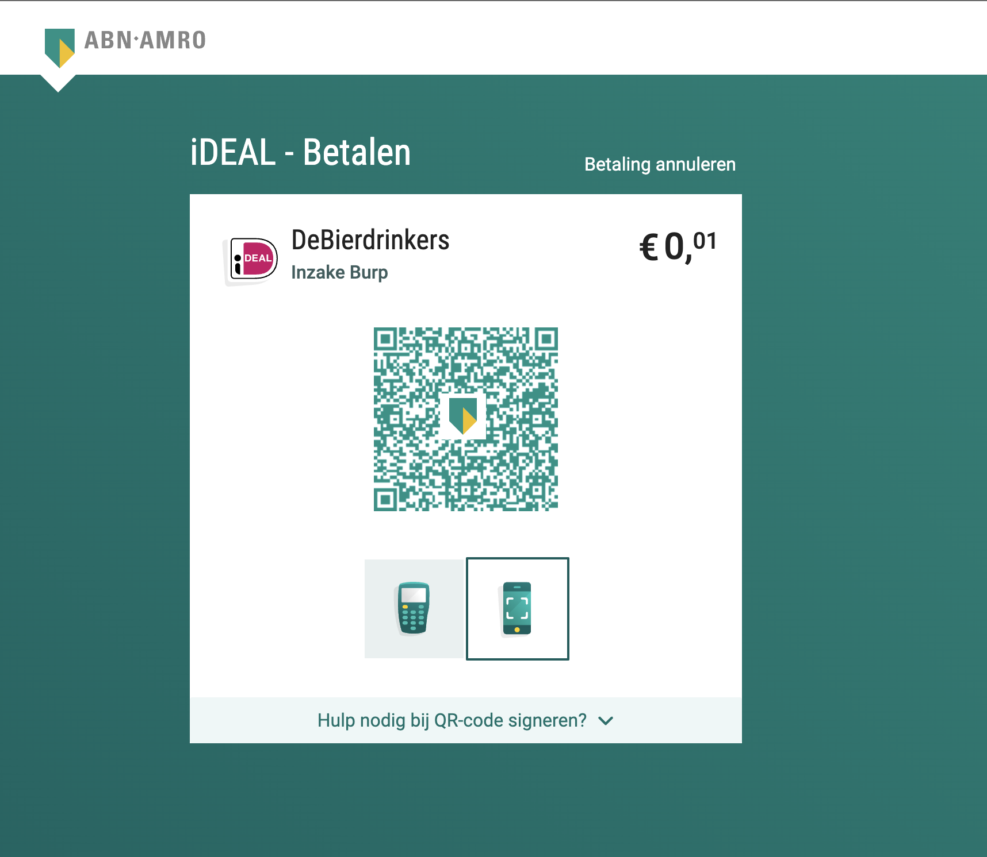


Slide 3



FULL PROOF TESTING
A GUIDE TO STABLE APPLICATION
by Illia Lebid

Slide 4
Traceability matrix
Actions | Expected result | Is tested
User opens the catalogue | List of products is shown | NO
User bla bla | Site is bla bla bla | NO
User blaaaa | Site is blaaaa blaa | NO
User bla | Site is bla and bla bla | NO
User bla bla bla bla | Site is down | NO

Slide 5
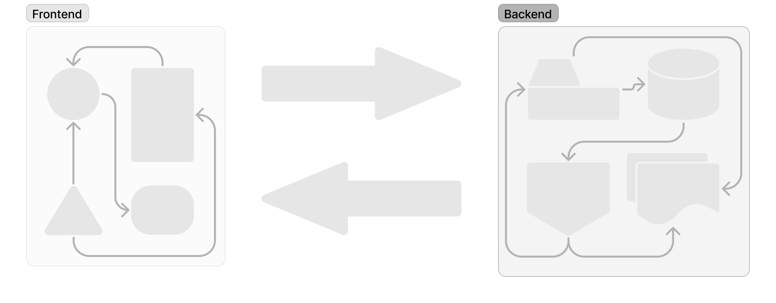
Unit, functional, e2e, contracts tests

Slide 6
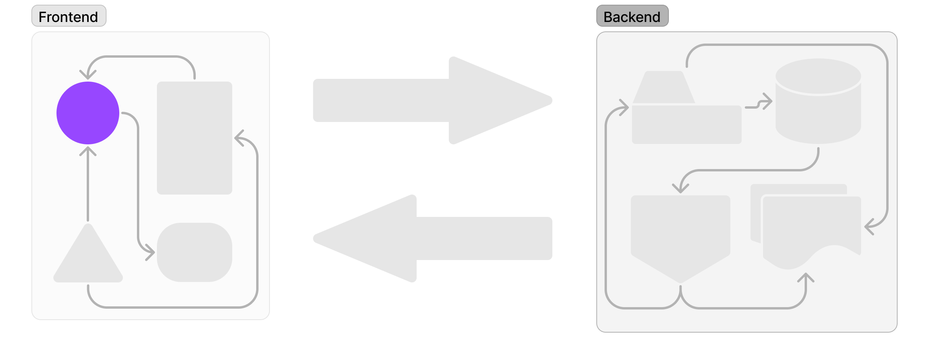
Unit, functional, e2e, contracts tests

Slide 7
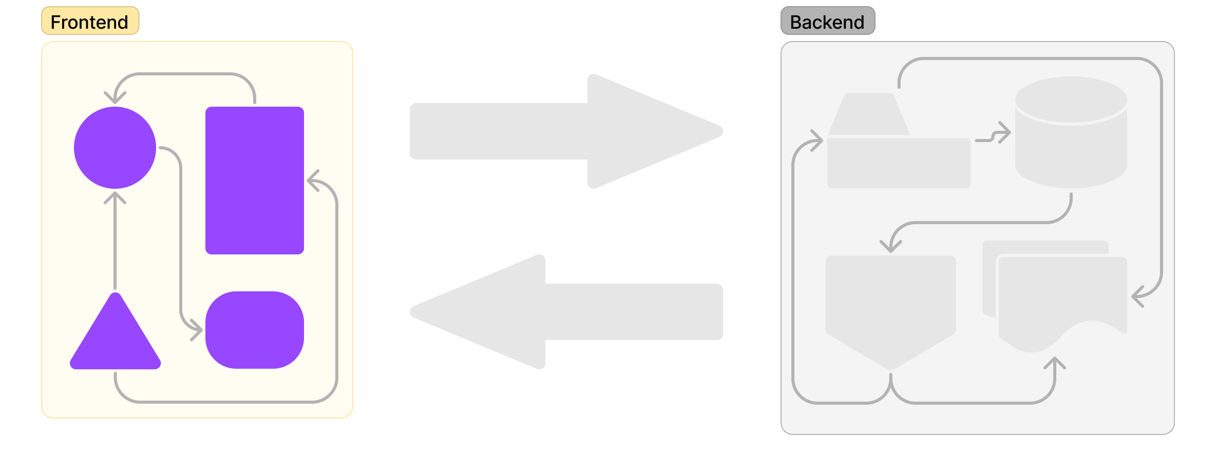
Unit, functional, e2e, contracts tests

Slide 8
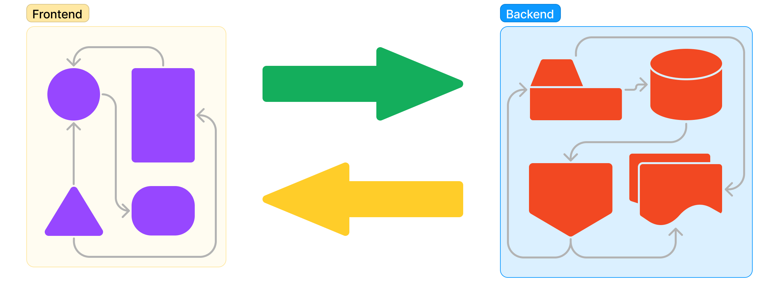
Unit, functional, e2e, contracts tests

Slide 9
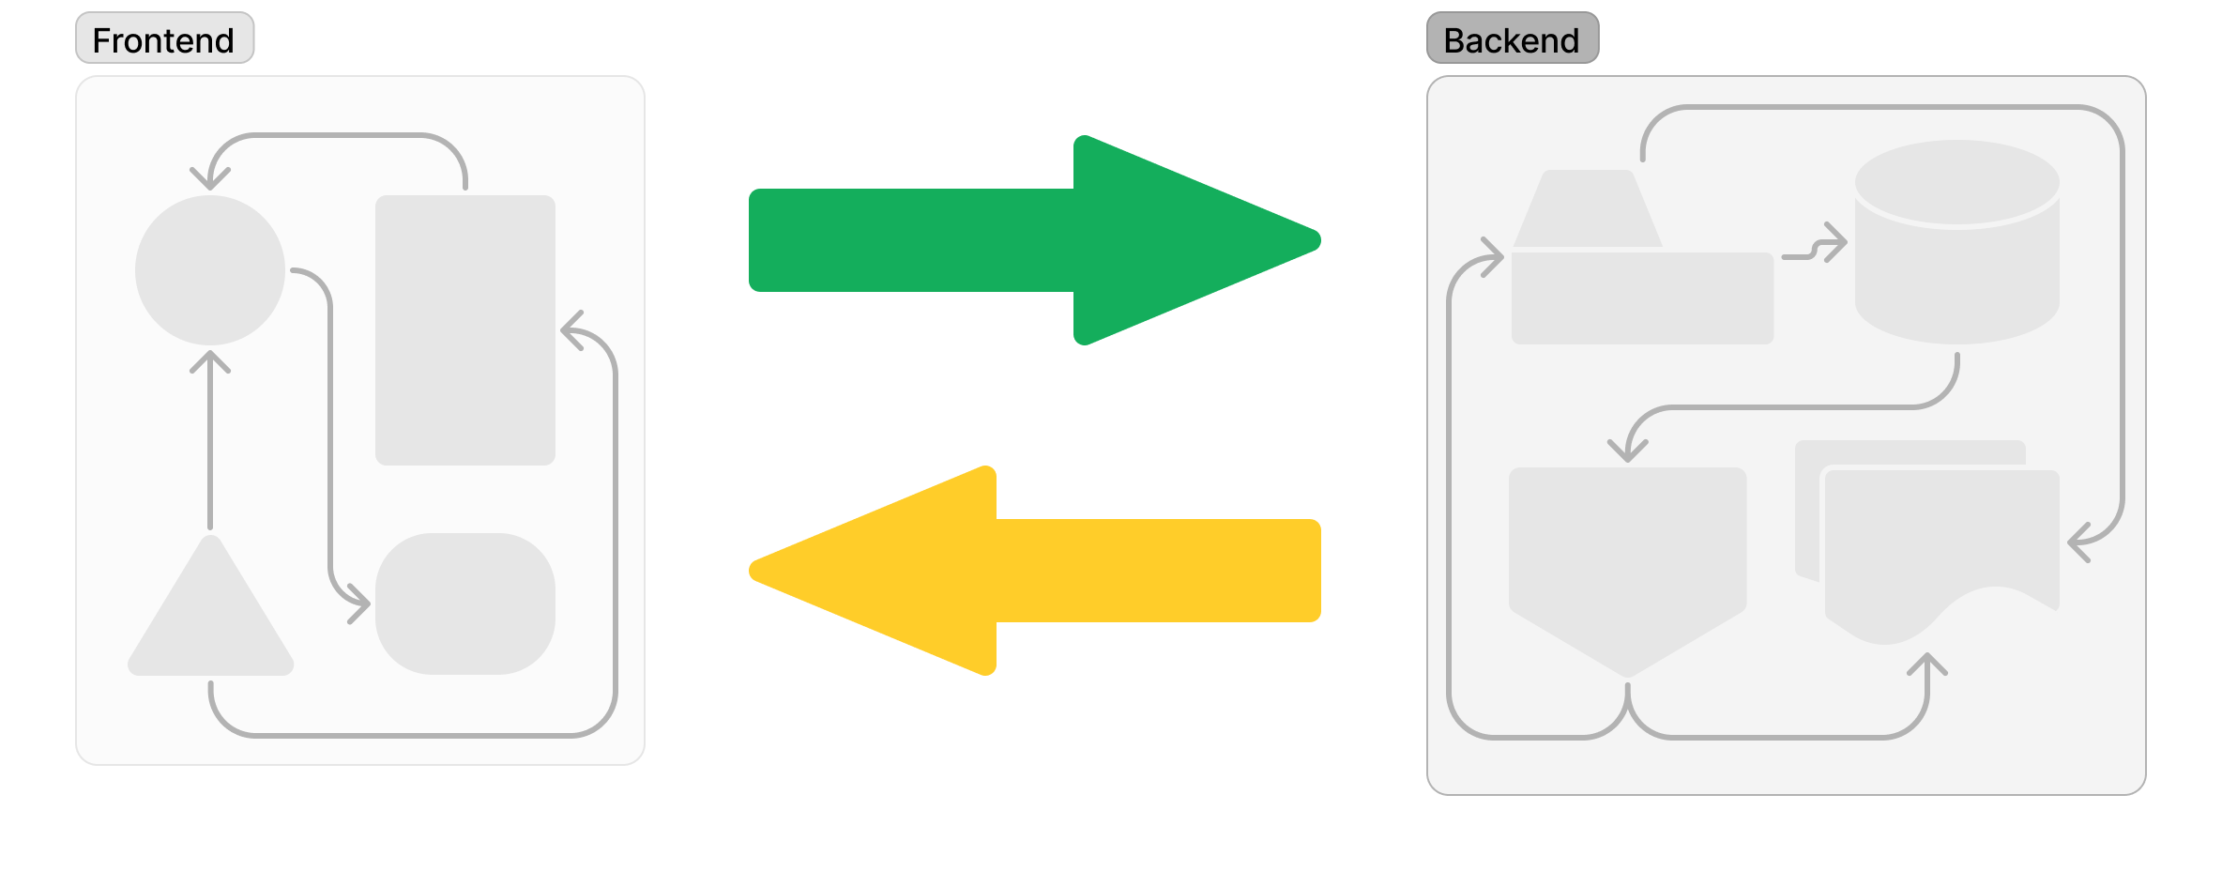
Unit, functional, e2e, contracts tests

Slide 11
Accessibility tests
Add a picture

Slide 12
Performance tests
Add a picture

Slide 13
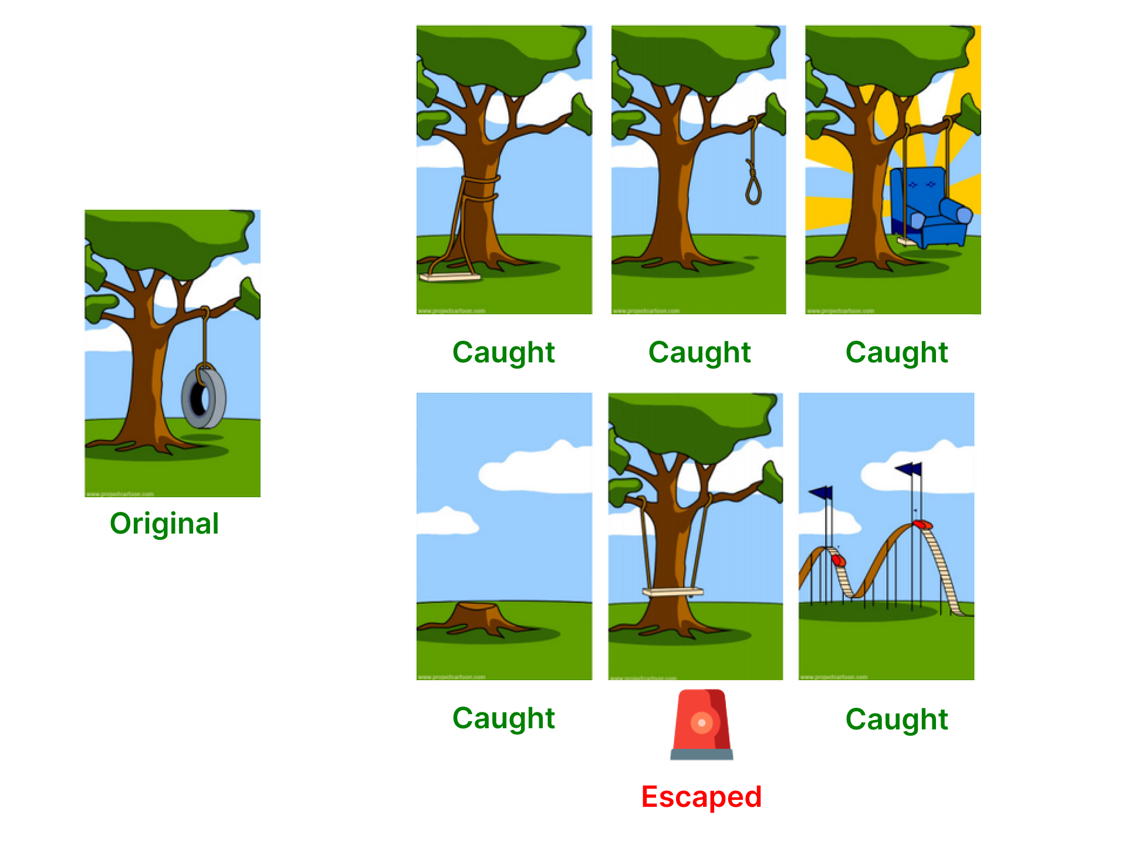
Mutation tests

Slide 14
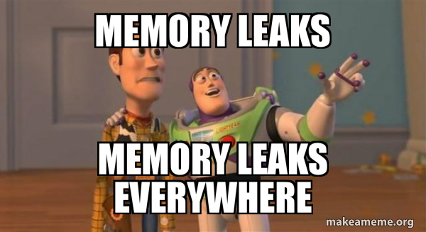
Memory leakage tests

Slide 15





Snapshot tests

Slide 16

Security tests
This Photo by Unknown Author is licensed under CC BY-NC

Slide 17

Code quality tests

Slide 18
All at once
Unit
Mutation
Functional
Memory leakage
E2E
Snapshot
Contracts
Security
Accessibility
Code quality
Performance

Slide 19
Manual
Testing pyramid
Functional
Static
(Performance, Security, Code quality, Mutation, Memory leakage, Contracts, Accessibility, Snapshots)
E2E
Unit

Slide 20
Manual
Testing pyramid
Functional
Static
(Performance, Security, Code quality, Mutation, Memory leakage, Accessibility, Snapshots)
E2E
Unit

Slide 21
Manual
Testing pyramid
Functional
Static
(Performance, Security, Code quality, Mutation, Memory leakage, Accessibility, Snapshots)
E2E
Unit
(and maybe Contracts)

Slide 22
Manual
Testing pyramid
Functional
Static
(Performance, Security, Code quality, Mutation, Memory leakage, Accessibility, Snapshots)
E2E
Unit
(and maybe Contracts)

Slide 23
Manual
Testing pyramid
Functional
Static
(Performance, Security, Code quality, Mutation, Memory leakage, Accessibility, Snapshots)
E2E
Unit
(and maybe Contracts)

Slide 24
Manual
Testing pyramid
Functional
Static
(Performance, Security, Code quality, Mutation, Memory leakage, Accessibility, Snapshots)
E2E
Unit
(and maybe Contracts)

Slide 25

Integration with the pipeline

Slide 26
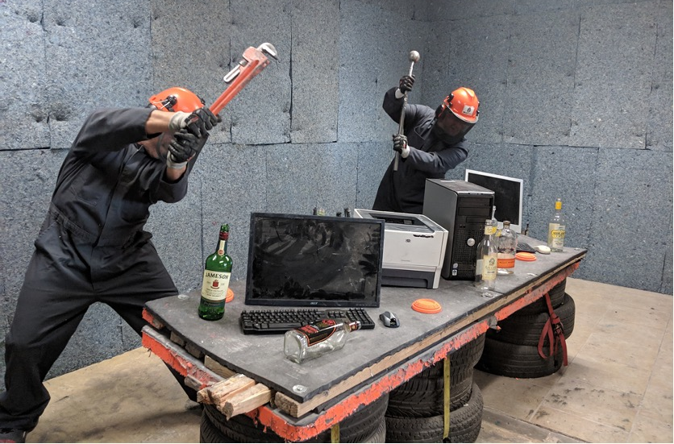
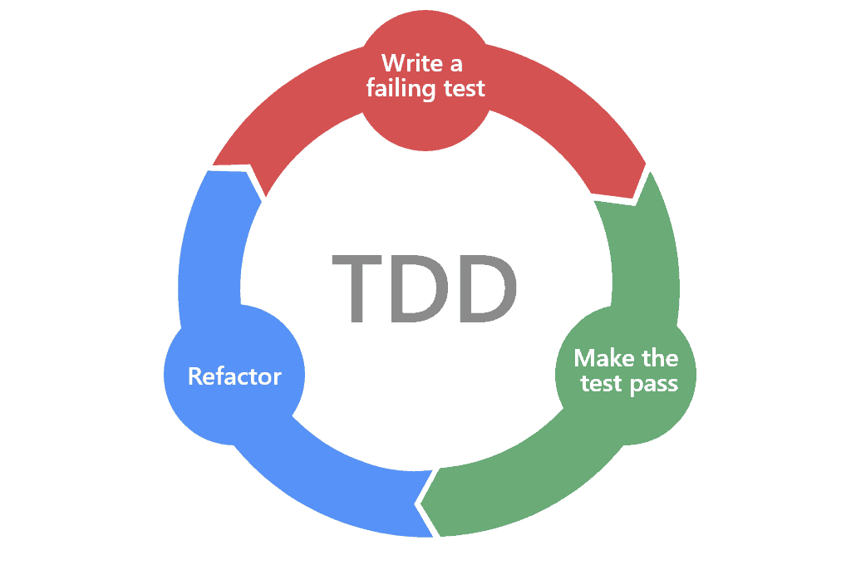
Breaking the tests + Test driven development

Slide 27


Example (Unit testing)
function calculateDiscount(price) {
}
It should:
Give 0% discount if price is less than 1000
Give 10% discount if price is more than 1000
Throw an error if price is not provided
> calculateDiscount(10)
undefined

Slide 28

Example (Unit testing)
function calculateDiscount(price) {
return price;
}
It should:
Give 0% discount if price is less than 1000
Give 10% discount if price is more than 1000
Throw an error if price is not provided
> calculateDiscount(10)
10

Slide 29
Example (Unit testing)
function calculateDiscount(price) {
return price;
}
It should:
Give 0% discount if price is less than 1000
Give 10% discount if price is more than 1000
Throw an error if price is not provided
> calculateDiscount(5000)
5000

Slide 30
Example (Unit testing)
function calculateDiscount(price) {
if(price >= 1000) return price * 0.9;
return price;
}
It should:
Give 0% discount if price is less than 1000
Give 10% discount if price is more than 1000
Throw an error if price is not provided
> calculateDiscount(5000)
4500

Slide 31
Example (Unit testing)
function calculateDiscount(price) {
if(price >= 1000) return price * 0.9;
return price;
}
It should:
Give 0% discount if price is less than 1000
Give 10% discount if price is more than 1000
Throw an error if price is not provided
> calculateDiscount()
undefined

Slide 32
Example (Unit testing)
function calculateDiscount(price) {
if(!price) throw new Error('PriceIsARequiredParameter’);
if(price >= 1000) return price * 0.9;
return price;
}
It should:
Give 0% discount if price is less than 1000
Give 10% discount if price is more than 1000
Throw an error if price is not provided
> calculateDiscount()
Uncaught error: PriceIsARequiredParameter

Slide 33
Example (Unit testing)
function calculateDiscount(price) {
if(!price) throw new Error('PriceIsARequiredParameter’);
if(price >= 1000) return price * 0.8;
return price;
}
It should:
Give 0% discount if price is less than 1000
Give 10% discount if price is more than 1000
Throw an error if price is not provided
> calculateDiscount(5000)
4000

Slide 34
Example (Unit testing)
function calculateDiscount(price) {
if(!price) return false;
if(price >= 1000) return price * 0.9;
return price;
}
It should:
Give 0% discount if price is less than 1000
Give 10% discount if price is more than 1000
Throw an error if price is not provided
> calculateDiscount()
false

Slide 35
Example (Unit testing)
function calculateDiscount(price) {
if(!price) throw new Error('PriceIsARequiredParameter’);
if(price >= 1000) return price * 0.9;
return price - 2;
}
It should:
Give 0% discount if price is less than 1000
Give 10% discount if price is more than 1000
Throw an error if price is not provided
> calculateDiscount(10)
8

Slide 36
Example (Unit testing)
function calculateDiscount(price) {
if(!price) throw new Error('PriceIsARequiredParameter’);
if(price >= 1000) return price * 0.9;
return price;
}
It should:
Give 0% discount if price is less than 1000
Give 10% discount if price is more than 1000
Throw an error if price is not provided
> calculateDiscount(10)
10

Slide 37
Example (Unit testing)
function calculateDiscount(price) {
if(!price) throw new Error('PriceIsARequiredParameter’);
if(price >= 1000) return price * 0.9;
return price;
}
It should:
Give 0% discount if price is less than 1000
Give 10% discount if price is more than 1000
Throw an error if price is not provided
> calculateDiscount('Free')
Free

Slide 38
Example (Unit testing)
function calculateDiscount(price) {
if(!price) throw new Error('PriceIsARequiredParameter’);
if(price >= 1000) return price * 0.9;
return price;
}
It should:
Give 0% discount if price is less than 1000
Give 10% discount if price is more than 1000
Throw an error if price is not provided
Throw an error if price is not a number
> calculateDiscount('Free')
Free

Slide 39
Example (Unit testing)
function calculateDiscount(price) {
if(typeof price === 'number') {
throw new Error(PriceMustBeNumber’);
}
if(!price) throw new Error('PriceIsARequiredParameter’);
if(price >= 1000) return price * 0.9;
return price;
}
It should:
Give 0% discount if price is less than 1000
Give 10% discount if price is more than 1000
Throw an error if price is not provided
Throw an error if price is not a number
> calculateDiscount('Free')
Uncaught error: PriceIsARequiredParameter

Slide 40
Example (Unit testing)
function calculateDiscount(price) {
if(typeof price === 'number') {
throw new Error(PriceMustBeNumber’);
}
if(!price) throw new Error('PriceIsARequiredParameter’);
if(price >= 1000) return price * 0.9;
return price;
}
It should:
Give 0% discount if price is less than 1000
Give 10% discount if price is more than 1000
Throw an error if price is not provided
Throw an error if price is not a number
> calculateDiscount(1000)
900

Slide 41
Example (Unit testing)
function calculateDiscount(price) {
if(typeof price === 'number') {
throw new Error(PriceMustBeNumber’);
}
if(!price) throw new Error('PriceIsARequiredParameter’);
if(price > 1000) return price * 0.9;
return price;
}
It should:
Give 0% discount if price is less than 1000
Give 10% discount if price is more than 1000
Throw an error if price is not provided
Throw an error if price is not a number
> calculateDiscount(1000)
1000

Slide 42
Example (Unit testing)
function calculateDiscount(price) {
if(typeof price === 'number') {
throw new Error(PriceMustBeNumber’);
}
if(!price) throw new Error('PriceIsARequiredParameter’);
if(price > 1000) return price * 0.9;
return price;
}
It should:
Give 0% discount if price is less than 1000
Give 10% discount if price is more than 1000
Throw an error if price is not provided
Throw an error if price is not a number
Give 10% discount if price is 1000
> calculateDiscount(1000)
1000

Slide 43
Example (Unit testing)
function calculateDiscount(price) {
if(typeof price === 'number') {
throw new Error(PriceMustBeNumber’);
}
if(!price) throw new Error('PriceIsARequiredParameter’);
if(price >= 1000) return price * 0.9;
return price;
}
It should:
Give 0% discount if price is less than 1000
Give 10% discount if price is more than 1000
Throw an error if price is not provided
Throw an error if price is not a number
Give 10% discount if price is 1000
> calculateDiscount(1000)
900

Slide 44
Recap
Recap of the presentation

Slide 45


Q&A
My LinkedIn https://www.linkedin.com/in/illia-lebid

